Slide 1
Overcoming Active Directory Woes with Plain Text Caches and Replacing Passwords
Jason St. John, Senior HPC Infrastructure Engineer
Alex Younts, Senior Staff HPC Infrastructure Engineer

Slide 2
Who We Are
Guardant Health is a blood-sample-based cancer diagnostics company
Bioinformatics is our core:
Sequence tumor DNA floating in patient blood sample
Run bioinformatics code on HPC system
Write out data and notify oncologist
Results inform oncologist on specific mutations that indicate use of drug A vs. drug B
Turnaround time is important!
Need results sent to oncologist ASAP so patients can start treatment
Job failures delay patient treatment

Slide 3
Why are we having so many job failures?
Compute nodes must be able to resolve user and group names at job launch
Many job start failures every day due to:
Cruft and slop in Active Directory database
AD servers routinely failing to answer queries
AD OUs had large variation for where nodes were assigned
Rate limiting on the cluster NAT IP address
sssd misconfigurations and cruft
and more!

Slide 4
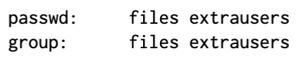

A ray of sunshine… libnss-extrausers!
Provides supplemental /etc/{passwd,group} files in /var/lib/extrausers
Enable by adding this to /etc/nsswitch.conf
These supplemental files are caches of AD!
Dump it
Clean it
Customize it
Copy it

Slide 5

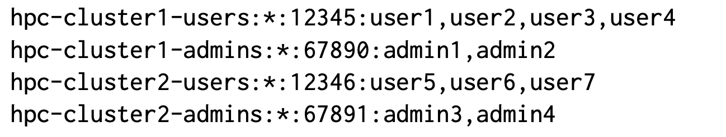
Trivial Group-Based Authorization
Appending custom groups to extrausers files
Flat files managed in Git for version control:
Easy access control via sshd’s AllowGroups option:
AllowGroups hpc-cluster1-users hpc-cluster1-admins
Faster turnaround for changes than tickets to IT

Slide 6
Throw authentication daemons in the trash
Throw sssd in the dumpster where it belongs
You can do away with auth daemons like sssd
Use SSH keys for logging in
Replace sudo passwords with Google Authenticator
tokens
Run a single bastion host with password logins still enabled
Allows users to configure SSH keys
“You can’t have any services break, if you don’t have any services”

Slide 7
Thank You Any questions?
Jason St. John
Senior HPC Infrastructure Engineer
jstjohn@guardanthealth.com
Alex Younts
Senior Staff HPC Infrastructure Engineer
ayounts@guardanthealth.com

